Slide 1
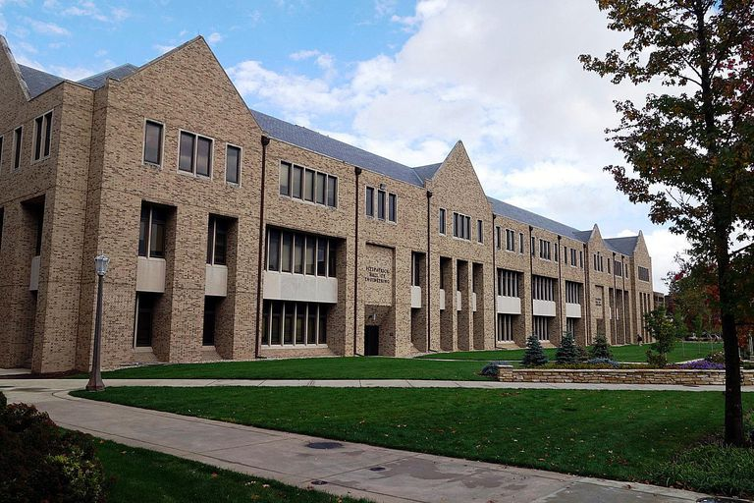
Lecture 00 – Introduction to Computer Architecture
1
Dr. Matthew Morrison
Assistant Teaching Professor
University of Notre Dame
January 16, 2024

Slide 2
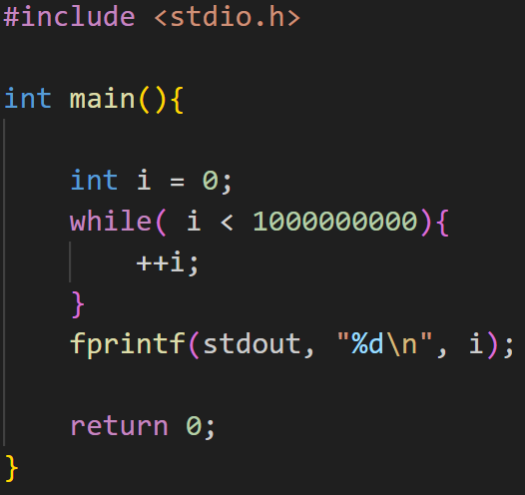
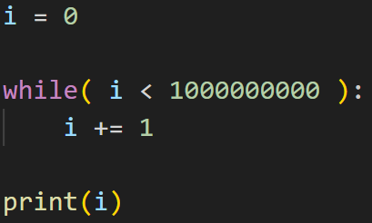
An Introductory Case Study
Let’s compare the run time of a while loop counting to 1,000,000,000
C vs Python
What do you think will happen?

Slide 3

Scooter Computer and Mr. Chips

Slide 4
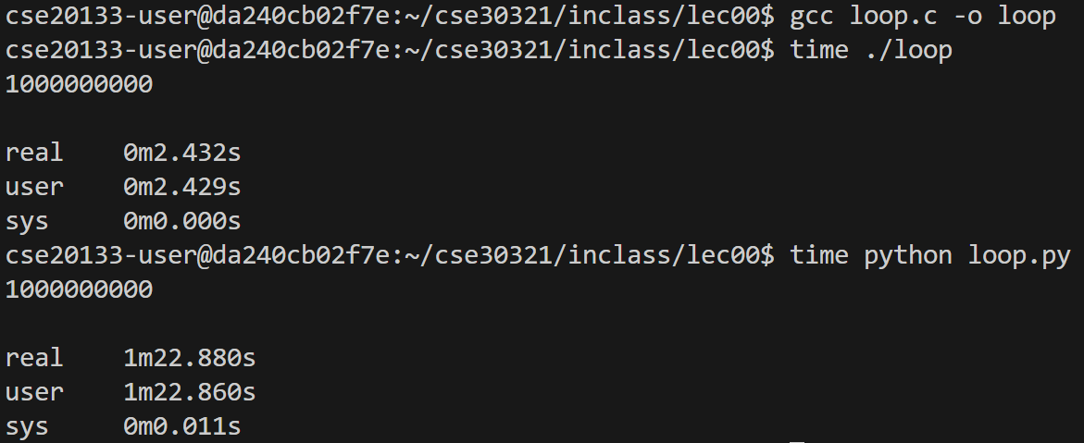
Time Comparison

Slide 5
Think, Pair, and Share
When would you want to use Python in your programming?
When would you want to use C in your programming?
When would you want to use Assembly Language in your programming?

Slide 6
The Concept of a Computer

Slide 7
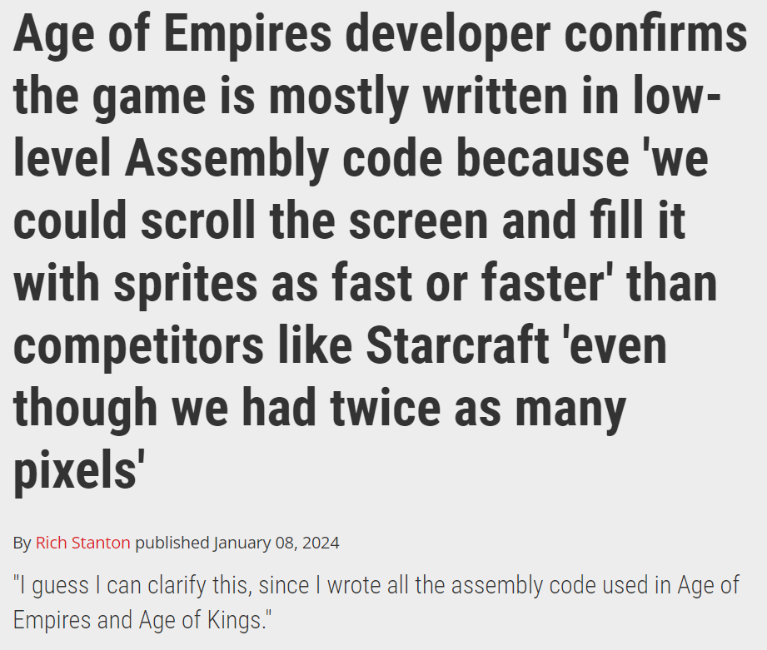
In the News
Source

Slide 8
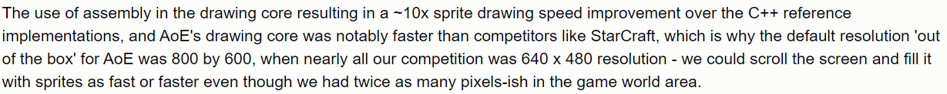
In the News
Source

Slide 9
A look under the hood
Let’s look at what happens when we generate assembly language
gcc –S loop.c
python –m dis loop.py
C runs directly in the local machine architecture
Python runs in the Virtual Machine

Slide 10
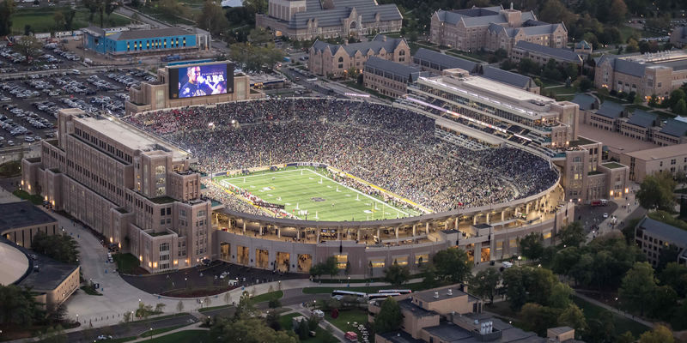
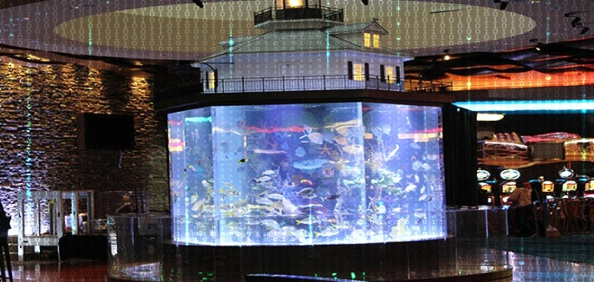
Abstractions in Programming
Hackers attack Casino’s fish tank thermometer to obtain sensitive data

Slide 11
Why this course: Computer Security
Spectre, Meltdown
Likely tens of billions of dollars impact
Stealing Intel encryption keys
Unlocking features in Tesla
Prof. Morrison’s Patent

Slide 12

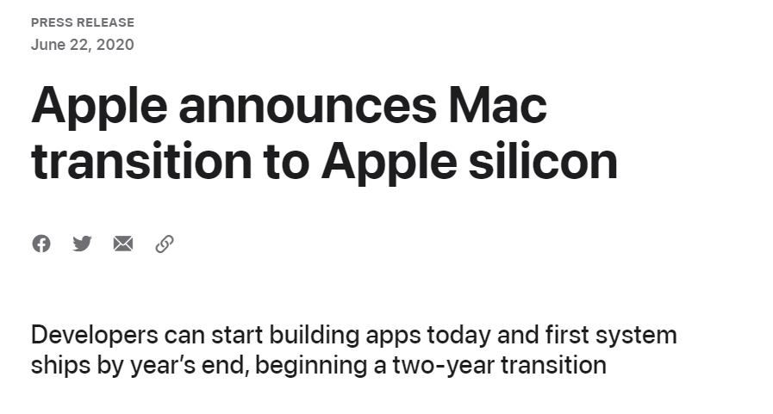
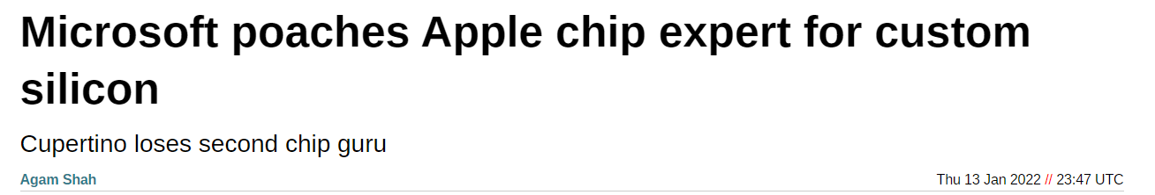
Why this course: Custom Silicon
Notes:
https://www.cnet.com/tech/computing/google-developing-its-own-arm-based-processors-for-chromebooks-report-says/
https://www.cnbc.com/2021/09/06/why-tesla-apple-google-and-facebook-are-designing-their-own-chips.html
https://www.theregister.com/2022/01/13/microsoft_apple_chip_expert/
https://www.apple.com/newsroom/2020/06/apple-announces-mac-transition-to-apple-silicon/
https://siliconangle.com/2023/07/06/googles-first-fully-custom-pixel-smartphone-chip-delayed-2025/

Slide 13
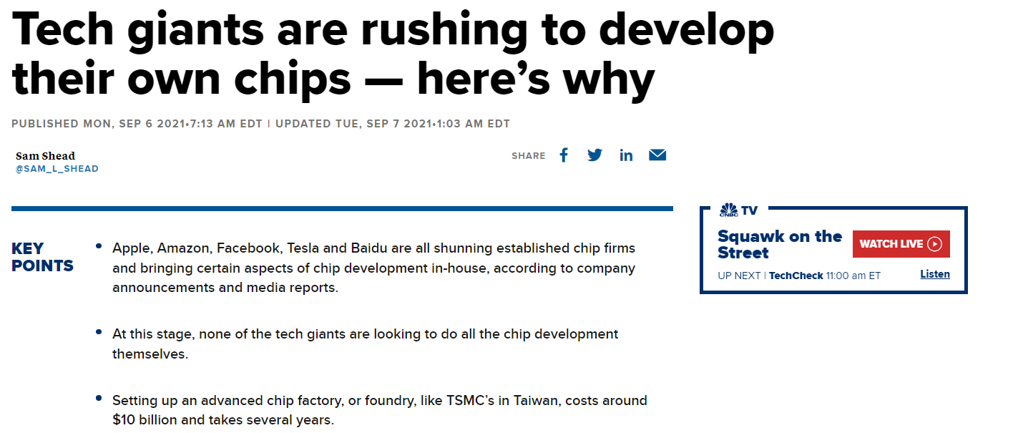
Why this course: Custom Silicon
Notes:
https://www.cnet.com/tech/computing/google-developing-its-own-arm-based-processors-for-chromebooks-report-says/
https://www.cnbc.com/2021/09/06/why-tesla-apple-google-and-facebook-are-designing-their-own-chips.html
https://www.theregister.com/2022/01/13/microsoft_apple_chip_expert/
https://www.apple.com/newsroom/2020/06/apple-announces-mac-transition-to-apple-silicon/
https://siliconangle.com/2023/07/06/googles-first-fully-custom-pixel-smartphone-chip-delayed-2025/

Slide 14
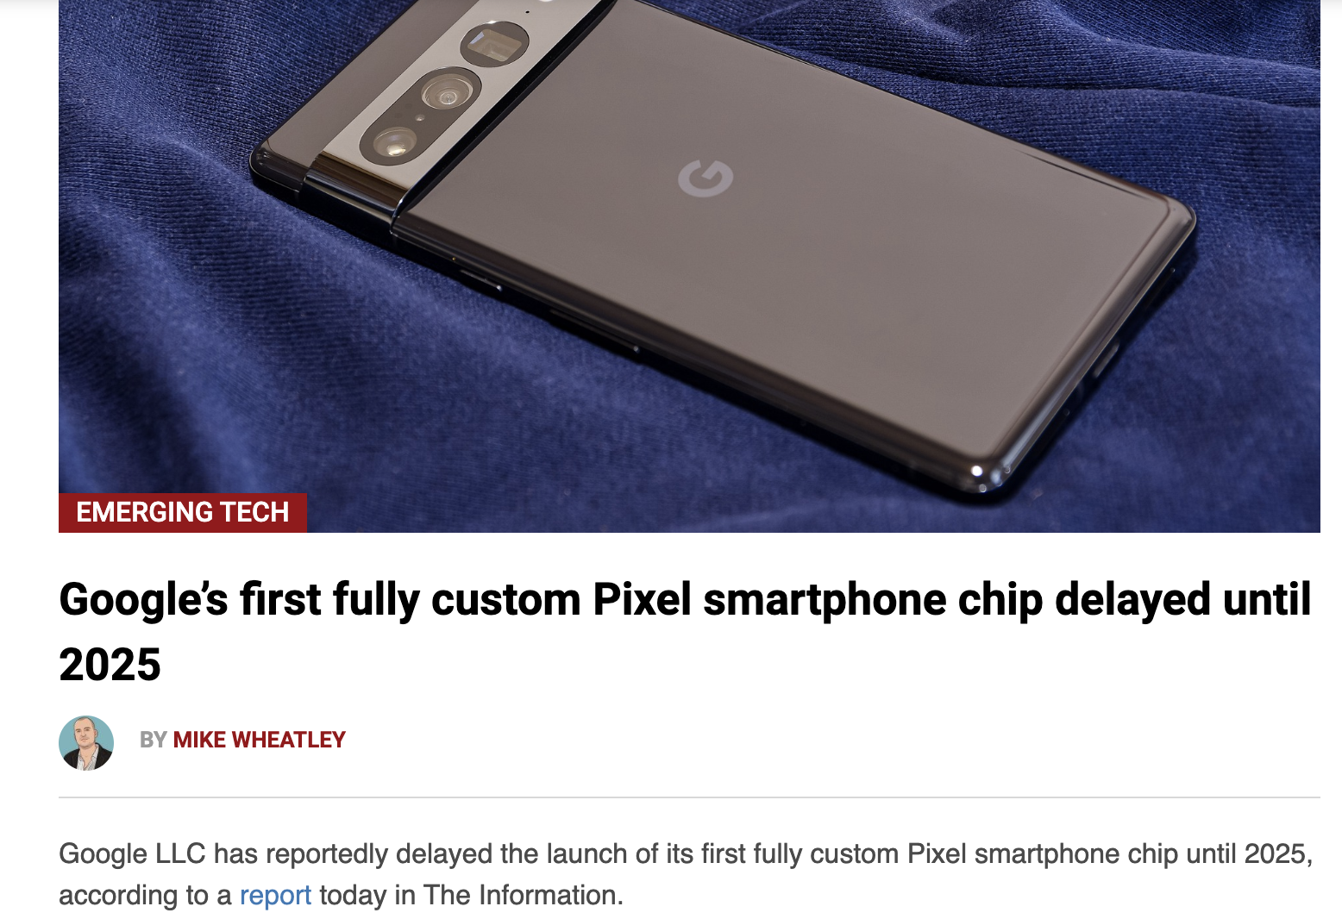
Why this course: Custom Silicon
Notes:
https://www.cnet.com/tech/computing/google-developing-its-own-arm-based-processors-for-chromebooks-report-says/
https://www.cnbc.com/2021/09/06/why-tesla-apple-google-and-facebook-are-designing-their-own-chips.html
https://www.theregister.com/2022/01/13/microsoft_apple_chip_expert/
https://www.apple.com/newsroom/2020/06/apple-announces-mac-transition-to-apple-silicon/
https://siliconangle.com/2023/07/06/googles-first-fully-custom-pixel-smartphone-chip-delayed-2025/

Slide 15

Why this course: Custom Silicon
Notes:
https://www.cnet.com/tech/computing/google-developing-its-own-arm-based-processors-for-chromebooks-report-says/
https://www.cnbc.com/2021/09/06/why-tesla-apple-google-and-facebook-are-designing-their-own-chips.html
https://www.theregister.com/2022/01/13/microsoft_apple_chip_expert/
https://www.apple.com/newsroom/2020/06/apple-announces-mac-transition-to-apple-silicon/
https://siliconangle.com/2023/07/06/googles-first-fully-custom-pixel-smartphone-chip-delayed-2025/

Slide 16

Under the C…

Slide 17
Why Computer Architecture?
What are your current opinions on this course?
Why do you think you are required to take this class?
Let’s put all these thoughts on the board

Slide 18
What is Computer Architecture?
Story Time: Intel interview

Slide 19
What is Computer Architecture?
Computer Architecture
System attributes of a computer that contribute to its logical execution and are visible to the programmer
Instruction set
Data representation
I/O mechanisms
Memory addressing

Slide 20
What is Computer Architecture?
Computer Architecture
System attributes of a computer that contribute to its logical execution and are visible to the programmer
Instruction set
Data representation
I/O mechanisms
Memory addressing

Slide 21
What is Computer Architecture?
Computer Architecture
System attributes of a computer that contribute to its logical execution and are visible to the programmer
Instruction set
Data representation
I/O mechanisms
Memory addressing

Slide 22
What is Computer Architecture?
Computer Architecture
System attributes of a computer that contribute to its logical execution and are visible to the programmer
Instruction set
Data representation
I/O mechanisms
Memory addressing

Slide 23
What is Computer Architecture?
Computer Architecture
System attributes of a computer that contribute to its logical execution and are visible to the programmer
Instruction set
Data representation
I/O mechanisms
Memory addressing

Slide 24
What is Computer Architecture?
Computer Architecture
System attributes of a computer that contribute to its logical execution and are visible to the programmer
Instruction set
Data representation
I/O mechanisms
Memory addressing

Slide 25
What is Computer Architecture?
Computer Organization
Physical details of a computer that are transparent to the programmer
Hardware implementation of an instruction
Control signals
Memory technology (cache, virtual)
ALU/CPU/CU designs
Transparent - a computing process or interface functioning without the user being aware of its presence
Not Invisible

Slide 26
What is Computer Architecture?
Computer Organization
Physical details of a computer that are transparent to the programmer
Hardware implementation of an instruction
Control signals
Memory technology (cache, virtual)
ALU/CPU/CU designs
Transparent - a computing process or interface functioning without the user being aware of its presence
Not Invisible

Slide 27
What is Computer Architecture?
Computer Organization
Physical details of a computer that are transparent to the programmer
Hardware implementation of an instruction
Control signals
Memory technology (cache, virtual)
ALU/CPU/CU designs
Transparent - a computing process or interface functioning without the user being aware of its presence
Not Invisible

Slide 28
What is Computer Architecture?
Computer Organization
Physical details of a computer that are transparent to the programmer
Hardware implementation of an instruction
Control signals
Memory technology (cache, virtual)
ALU/CPU/CU designs
Transparent - a computing process or interface functioning without the user being aware of its presence
Not Invisible

Slide 29
What is Computer Architecture?
Computer Organization
Physical details of a computer that are transparent to the programmer
Hardware implementation of an instruction
Control signals
Memory technology (cache, virtual)
ALU/CPU/CU designs
Transparent - a computing process or interface functioning without the user being aware of its presence
Not Invisible

Slide 30
What is Computer Architecture?
Computer Organization
Physical details of a computer that are transparent to the programmer
Hardware implementation of an instruction
Control signals
Memory technology (cache, virtual)
ALU/CPU/CU designs
Transparent - a computing process or interface functioning without the user being aware of its presence
Not Invisible

Slide 31
What is Computer Architecture?
Computer Organization
Physical details of a computer that are transparent to the programmer
Hardware implementation of an instruction
Control signals
Memory technology (cache, virtual)
ALU/CPU/CU designs
Transparent - a computing process or interface functioning without the user being aware of its presence
Not Invisible

Slide 32
What is Computer Architecture?
Problem 1 on HW 1, Exam 1, and the Final Exam
“Define and differentiate between computer architecture and computer organization and give examples of each.”

Slide 33
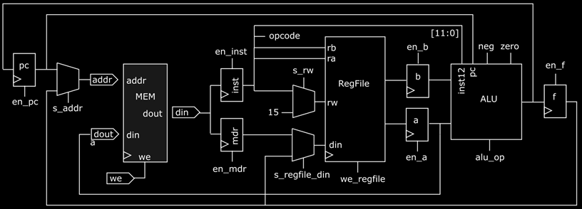
Recall from Logic Design
Albacore Architecture
What are the 5 stages of operation?

Slide 34
Recall from Logic Design
Instruction Fetch
Gets a compiled binary machine code instruction from the instruction memory, and loads it into the datapath

Slide 35
Recall from Logic Design
Instruction Decode
Decodes the machine instruction, and generates the control signals, determines the appropriate registers and memory locations, and the necessary operations to complete the instruction

Slide 36
Recall from Logic Design
Execute
Performs the operation dictated by the machine instruction

Slide 37
Recall from Logic Design
Data Memory
Performs the operation dictated by the machine instruction

Slide 38
Recall from Logic Design
Write Back
If the operation dictates that some information must be stored in temporary registers, it will be done at this stage

Slide 39
Computer Architecture Catalog Description
Introduction to basic architectural concepts that are present in current scalar machines, together with an introduction to assembly language programming, computer arithmetic, and performance evaluation.
Commercial computer-aided-design software is used to deepen the student's understanding of the top-down processor design methodology. MIPS-based assembly language will be used.

Slide 40
Computer Architecture Breakdown

Slide 41
Computer Architecture Breakdown
Microprocessor Die

Slide 42
Computer Architecture Breakdown
Off-chip memory
(1-transistor DRAM)
Microprocessor Die

Slide 43
Computer Architecture Breakdown
Core 1
Off-chip memory
(1-transistor DRAM)
Microprocessor Die

Slide 44
Computer Architecture Breakdown
Core 1
Combinational and sequential logic
Register file
Off-chip memory
(1-transistor DRAM)
Microprocessor Die

Slide 45
Computer Architecture Breakdown
Core 1
Core 2
Core 3
Core 4
Combinational and sequential logic
Register file
Off-chip memory
(1-transistor DRAM)
Microprocessor Die

Slide 46
Computer Architecture Breakdown
Code
Core 1
Core 2
Core 3
Core 4
Combinational and sequential logic
int main(void) {
int i;
int a, b, c;
for i=0; i<5; i++ {
a = (a*b) + c;
}
}
Register file
Off-chip memory
(1-transistor DRAM)
Microprocessor Die

Slide 47
Computer Architecture Breakdown
Code
Core 1
Core 2
Core 3
Core 4
Combinational and sequential logic
int main(void) {
int i;
int a, b, c;
for i=0; i<5; i++ {
a = (a*b) + c;
}
}
Register file
Off-chip memory
(1-transistor DRAM)
Microprocessor Die
… a = (a*b) + c; …
mul temp, a, b
00111 0011 1100 1000

Slide 48
Computer Architecture Breakdown
Code
Core 1
Core 2
Core 3
Core 4
Combinational and sequential logic
int main(void) {
int i;
int a, b, c;
for i=0; i<5; i++ {
a = (a*b) + c;
}
}
Register file
L3 cache memory (shared between cores)
(6T-SRAM)
Off-chip memory
(1-transistor DRAM)
Microprocessor Die
… a = (a*b) + c; …
mul temp, a, b
00111 0011 1100 1000

Slide 49
Computer Architecture Breakdown
Code
Core 1
Core 2
Core 3
Core 4
Combinational and sequential logic
int main(void) {
int i;
int a, b, c;
for i=0; i<5; i++ {
a = (a*b) + c;
}
}
Register file
L2 cache
(6T SRAM)
L2 cache
(6T SRAM)
L2 cache
(6T SRAM)
L2 cache
(6T SRAM)
L3 cache memory (shared between cores)
(6T-SRAM)
Off-chip memory
(1-transistor DRAM)
Microprocessor Die
… a = (a*b) + c; …
mul temp, a, b
00111 0011 1100 1000

Slide 50
Computer Architecture Breakdown
Code
Core 1
Core 2
Core 3
Core 4
Combinational and sequential logic
int main(void) {
int i;
int a, b, c;
for i=0; i<5; i++ {
a = (a*b) + c;
}
}
Register file
L1 cache
(6T SRAM)
L1 cache
(6T SRAM)
L1 cache
(6T SRAM)
L1 cache
(6T SRAM)
L2 cache
(6T SRAM)
L2 cache
(6T SRAM)
L2 cache
(6T SRAM)
L2 cache
(6T SRAM)
L3 cache memory (shared between cores)
(6T-SRAM)
Off-chip memory
(1-transistor DRAM)
Microprocessor Die
… a = (a*b) + c; …
mul temp, a, b
00111 0011 1100 1000
00111 0011 1100 1000

Slide 51
Computer Architecture Breakdown
Code
Core 1
Core 2
Core 3
Core 4
Combinational and sequential logic
int main(void) {
int i;
int a, b, c;
for i=0; i<5; i++ {
a = (a*b) + c;
}
}
Register file
L1 cache
(6T SRAM)
L1 cache
(6T SRAM)
L1 cache
(6T SRAM)
L1 cache
(6T SRAM)
L2 cache
(6T SRAM)
L2 cache
(6T SRAM)
L2 cache
(6T SRAM)
L2 cache
(6T SRAM)
L3 cache memory (shared between cores)
(6T-SRAM)
Off-chip memory
(1-transistor DRAM)
00111 0011 1100 1000
00111 0011 1100 1000
Microprocessor Die
… a = (a*b) + c; …
mul temp, a, b
00111 0011 1100 1000

Slide 52
Computer Architecture Breakdown
Code
Core 1
Core 2
Core 3
Core 4
Combinational and sequential logic
int main(void) {
int i;
int a, b, c;
for i=0; i<5; i++ {
a = (a*b) + c;
}
}
Register file
L1 cache
(6T SRAM)
L1 cache
(6T SRAM)
L1 cache
(6T SRAM)
L1 cache
(6T SRAM)
L2 cache
(6T SRAM)
L2 cache
(6T SRAM)
L2 cache
(6T SRAM)
L2 cache
(6T SRAM)
00111 0011 1100 1000
00111 0011 1100 1000
L3 cache memory (shared between cores)
(6T-SRAM)
Off-chip memory
(1-transistor DRAM)
00111 0011 1100 1000
Microprocessor Die
… a = (a*b) + c; …
mul temp, a, b
00111 0011 1100 1000

Slide 53
Computer Architecture Breakdown
Code
Core 1
Core 2
Core 3
Core 4
Combinational and sequential logic
int main(void) {
int i;
int a, b, c;
for i=0; i<5; i++ {
a = (a*b) + c;
}
}
Register file
L1 cache
(6T SRAM)
L1 cache
(6T SRAM)
L1 cache
(6T SRAM)
L1 cache
(6T SRAM)
00111 0011 1100 1000
L2 cache
(6T SRAM)
L2 cache
(6T SRAM)
L2 cache
(6T SRAM)
L2 cache
(6T SRAM)
00111 0011 1100 1000
L3 cache memory (shared between cores)
(6T-SRAM)
Off-chip memory
(1-transistor DRAM)
00111 0011 1100 1000
Microprocessor Die
… a = (a*b) + c; …
mul temp, a, b
00111 0011 1100 1000

Slide 54
Benefits of Computer Architecture
for(i=0; i<XSIZE; i=i+1) {
for(j=0; j<YSIZE; j=j+1) {
r = 0;
for(k=0; k<XSIZE; k=k+1) {
r = r + y[i][k] * z[k][j];
}
x[i][j] = r;
}
}
for(jj=0; jj<XSIZE; jj=jj+B) {
for(kk=0; kk<YSIZE; kk=kk+B) {
for(i=0; i<XSIZE; i=i+1) {
if((jj+B) < YSIZE) {
p = jj+B;
}
else {
p = YSIZE;
}
for(j=jj; j<p; j=j+1) {
r=0;
if((kk+B) < XSIZE) {
q = kk + B;
}
else {
q = XSIZE;
}
for(k=kk; k<q; k=k+1) {
r = r + y[i][k]*z[k][j];
}
x[i][j] = x[i][j] + r;
}
}
}
}

Slide 55
Benefits of Computer Architecture
for(i=0; i<XSIZE; i=i+1) {
for(j=0; j<YSIZE; j=j+1) {
r = 0;
for(k=0; k<XSIZE; k=k+1) {
r = r + y[i][k] * z[k][j];
}
x[i][j] = r;
}
}
for(jj=0; jj<XSIZE; jj=jj+B) {
for(kk=0; kk<YSIZE; kk=kk+B) {
for(i=0; i<XSIZE; i=i+1) {
if((jj+B) < YSIZE) {
p = jj+B;
}
else {
p = YSIZE;
}
for(j=jj; j<p; j=j+1) {
r=0;
if((kk+B) < XSIZE) {
q = kk + B;
}
else {
q = XSIZE;
}
for(k=kk; k<q; k=k+1) {
r = r + y[i][k]*z[k][j];
}
x[i][j] = x[i][j] + r;
}
}
}
}

Slide 56
Benefits of Computer Architecture
for(i=0; i<XSIZE; i=i+1) {
for(j=0; j<YSIZE; j=j+1) {
r = 0;
for(k=0; k<XSIZE; k=k+1) {
r = r + y[i][k] * z[k][j];
}
x[i][j] = r;
}
}
for(jj=0; jj<XSIZE; jj=jj+B) {
for(kk=0; kk<YSIZE; kk=kk+B) {
for(i=0; i<XSIZE; i=i+1) {
if((jj+B) < YSIZE) {
p = jj+B;
}
else {
p = YSIZE;
}
for(j=jj; j<p; j=j+1) {
r=0;
if((kk+B) < XSIZE) {
q = kk + B;
}
else {
q = XSIZE;
}
for(k=kk; k<q; k=k+1) {
r = r + y[i][k]*z[k][j];
}
x[i][j] = x[i][j] + r;
}
}
}
}

Slide 57
Why is the “ugly” code faster?
Core 1
Core 2
Core 3
Core 4
Combinational and sequential logic
Register file
We use this (on-chip, faster) memory more efficiently
L1 cache
(6T SRAM)
L1 cache
(6T SRAM)
L1 cache
(6T SRAM)
L1 cache
(6T SRAM)
L2 cache
(6T SRAM)
L2 cache
(6T SRAM)
L2 cache
(6T SRAM)
L2 cache
(6T SRAM)
00111 0011 1100 1000
L3 cache memory (shared between cores)
(6T-SRAM)
Off-chip memory
(1-transistor DRAM)
00111 0011 1100 1000
Microprocessor Die

Slide 58
Goal and Philosophy
RISC-V is a Reduced Instruction Set Computer
Goal
The main goal of the design is high performance in the execution of compiled code.
Philosophy
The basic philosophy of MIPS is to present an instruction set that is a compiler-driven encoding of the microengine. Thus, little or no decoding is needed and the instructions correspond closely to microcode instructions.

Slide 59
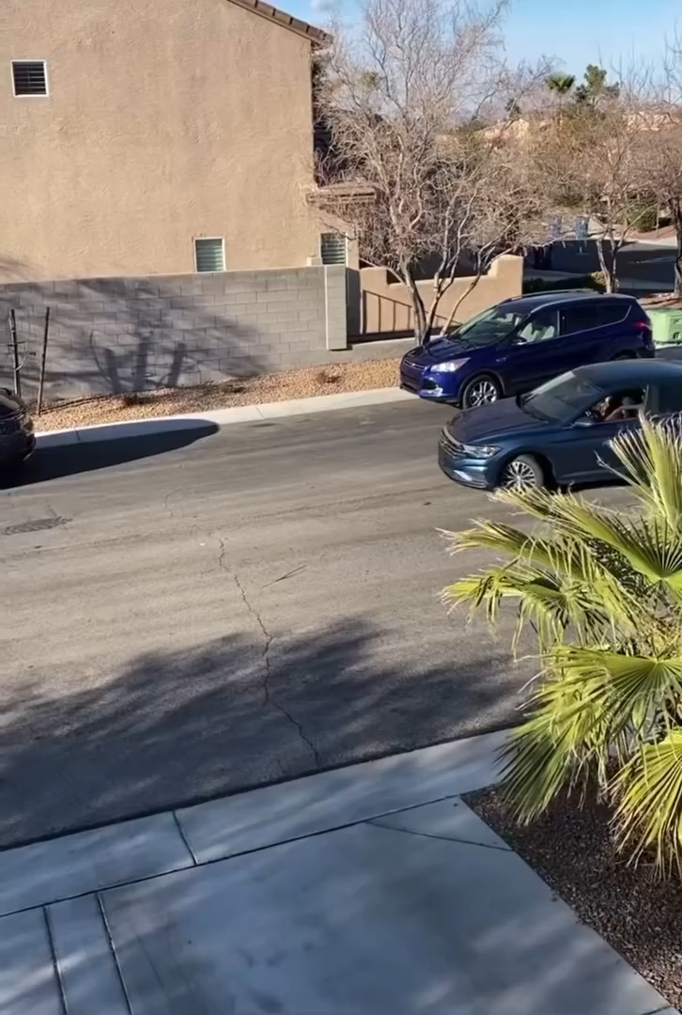
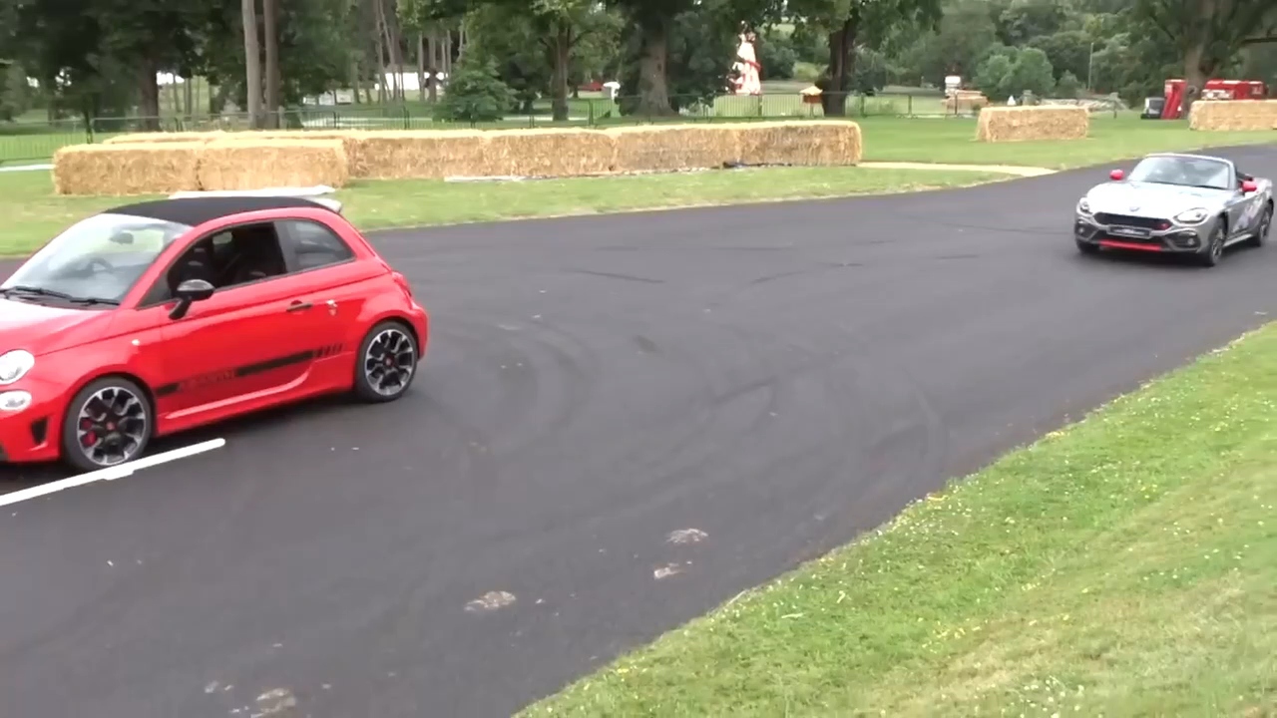
Efficient Memory Access
Effective computing is analogous to effective thinking
Source: https://www.youtube.com/watch?v=VDN1JWe3rAo
Source: https://www.youtube.com/watch?v=3l31bNE6LT0

Slide 60
Course Topics
Instruction Set Architecture (ISA) Review
Performance
RISC-V ISA (R-type, I-type, S-type, U-type)
RISC-V Selection and Repetition (SB-type)
RISC-V Procedure Calls (UJ-type, stack, nested calls)
Pipelining

Slide 61
Course Topics
Memory Hierarchy, Caches, Cache Performance
Virtual Memory
Out-of-order Execution
Side-channel attacks
Multicore and Parallel
Cache Coherence

Slide 62

Course Information
CSE 30321 – Computer Architecture
Required for CS and CPEG majors
TuTh - 11-12:15pm in DeBartolo Hall 116
Canvas Page
https://canvas.nd.edu/courses/82217

Slide 63
Textbook
CSE 30321 Computer Architecture zyBook
Sign in or create an account at https://learn.zybooks.com
Enter zyBook code: NDCSE30321MorrisonSpring2024
Subscribe. Cost is $97 for the semester.
Course Slack
https://app.slack.com/client/T0HJVP8MS/C06DND1TLBY
LinkedIn
https://www.linkedin.com/in/gregariousmatt/

Slide 64
Office Hours
My Office Hours in 178 Fitzpatrick Hall
M, Tu, W – 1-2pm
Th 1-3pm
Or by Appointment
TA Office Hours on Google Calendar
TA hours start in Week 2

Slide 65
Reading
15 Reading Assignments worth 100 points each
Most due on Tuesday at 11am at the beginning of each week
First Reading Assignment due this Thursday at 11am
Get ahead of any issues, start back in the studying habit
Let’s look at Lecture Notes and Schedule and the Reading outline

Slide 66
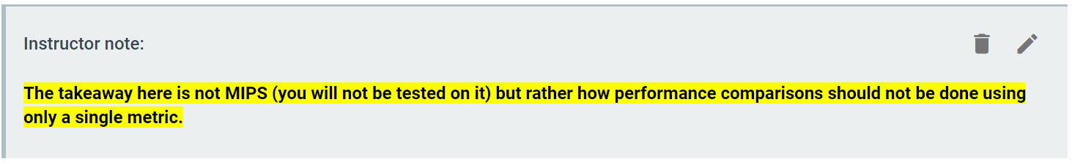
zyBook
Warning: readings may be longer than in Logic Design
Chapters tend to be longer, as do sections
Keep an eye out for “Instructor Notes”:
Occasionally, these will call out sections that you can skip and still receive full credit for the reading:
Sections marked optional may still be of interest

Slide 67
Homework Assignments
12 Homework Assignments work 600 points each
Assigned every Thursday and due the following Thursday
Except for the Thursdays prior to Exam 1 and Exam 2
Submitted to Gradescope

Slide 68
Three Exams
Exam 1 – Take Home
Time for 2 hours on Gradescope
Between 2/15/24 at 12:30pm and 2/16/24 at 5:00pm
2,000 points
Exam 2 – Take Home
Time for 2 hours on Gradescope
Between 3/28/24 at 12:30pm and 3/29/24 at 5:00pm
2,500 points

Slide 69
Three Exams
Final Exam
In Person, Timed
Wednesday, May 8th, 10:30am - 12:30pm
3,000 total points
Important Information
Review Guides posted 1 week early
Points increase to reflect your better understanding of my Exam expectations

Slide 70
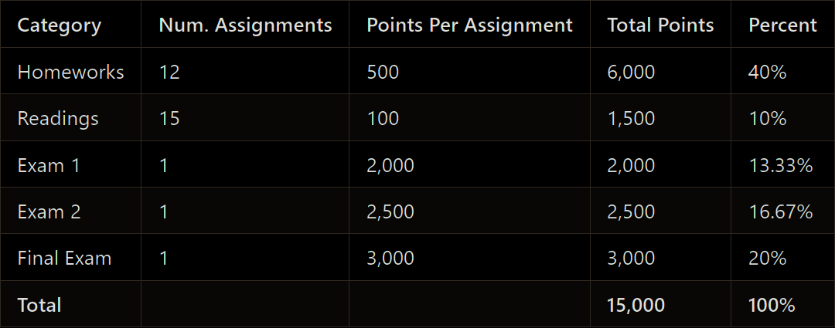
Total Points

Slide 71
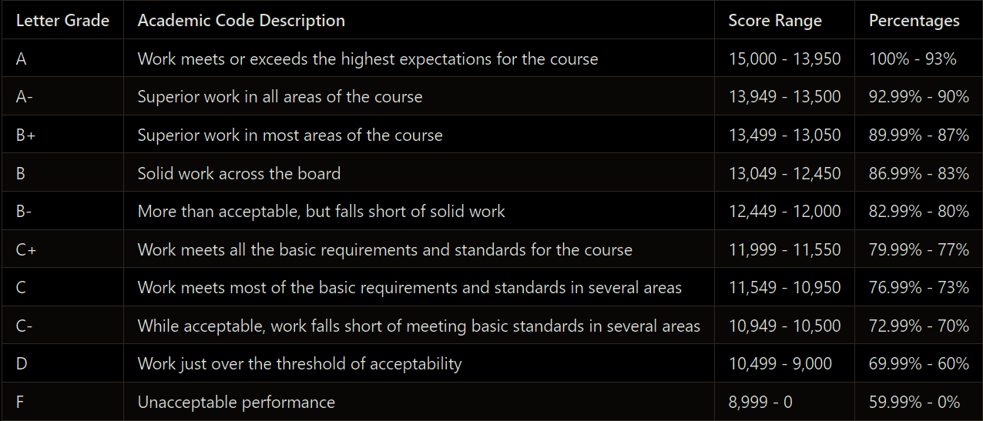
Grade Breakdown

Slide 72
Extension Tokens
72 hours for extensions on homework assignments
Not reading or Exams
Granted for instances such as illness
Not including University-excused extensions (attending a funeral, athletics, ect.)
Automatically granted if you haven’t used
A way for me to proactively help students

Slide 73
Out of Class Work Expectations
According to Federal Law, a "Credit Hour" is legally defined as follows:
An amount of work that reasonably approximates not less than:
One hour of classroom or direct faculty instruction and a minimum of two hours of out of class student work each week for approximately fifteen weeks for a semester
For this course: That is an average of 7.5 hours/week
Last 3 years of CIF Scores: 7.4 hours
If you are struggling, find me or a TA

Slide 74
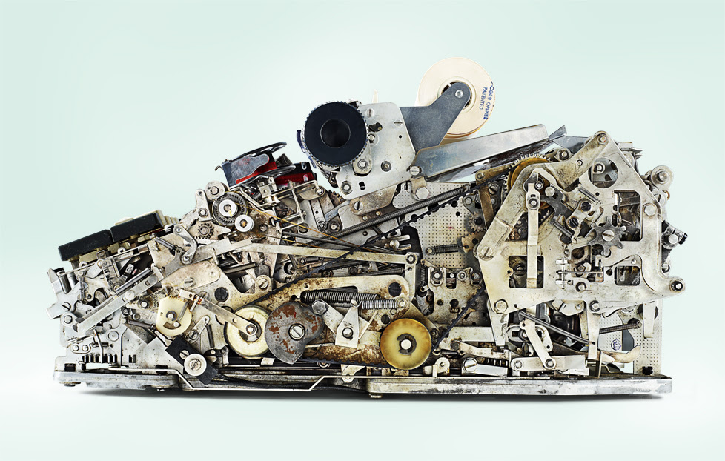
A Good Place to Discuss AI and Coding
An old calculator gives insight into a new problem…

Slide 75

A Good Place to Discuss AI and Coding
Someday, AI may be able to reliably develop engineering-quality code

Slide 76
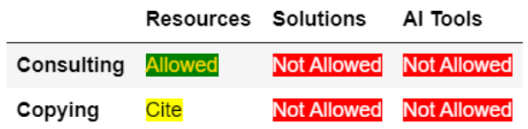
Academic Integrity
A simple rule of thumb

Slide 77
Jog Your Memory: Think, Pair, Share
Define and differentiate between computer architecture and computer organization and give examples of each.
State and briefly describe the five stages of the RISC datapath.
What is the goal of RISC?
What is the basic philosophy of RISC?

Slide 78
Unicorn Chaser: Last Minute!
What it’s like for the Professor when there is exactly one minute left in Lecture
Instagram Artist:
@jakekrantz
Source: https://www.instagram.com/p/CQPMA4qAMht/

Slide 79

Unicorn Chaser: Last Minute!
What it’s like for the Professor when there is exactly one minute left in Lecture
Instagram Artist:
@jakekrantz
Source: https://www.instagram.com/p/CQPMA4qAMht/

